Slide 1
A New Coupled 2D/1D Surface Runoff and Infiltration Model for Permeable Pavements
Marcus N. Gomes Jr¹., José Brasil, Marcio H. Giacomoni, Drew Johnson, A. T. Papagiannakis

Slide 2
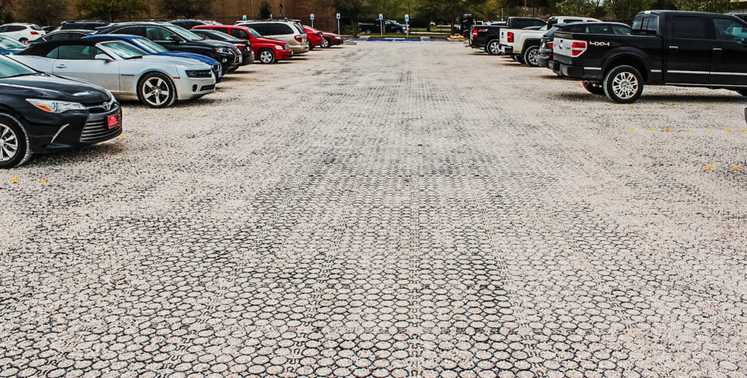
Motivation
Climate Change and urbanization will Require adaptive and resilient urban Infrastructure. Parsimonious yet robust tools are required for future water resources planning and management
Objective
Develop a skillful model capable of simulating low-impact development continuous simulation dynamics under varied climatologic forcing

Slide 3

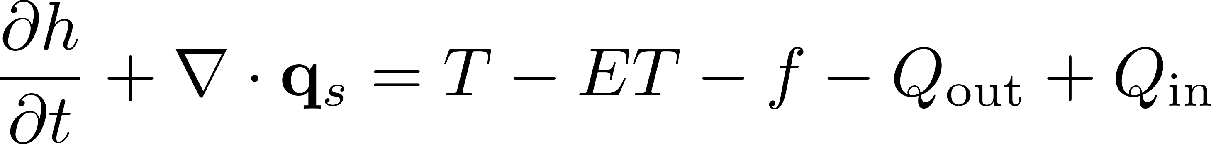
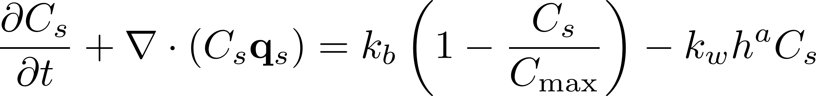
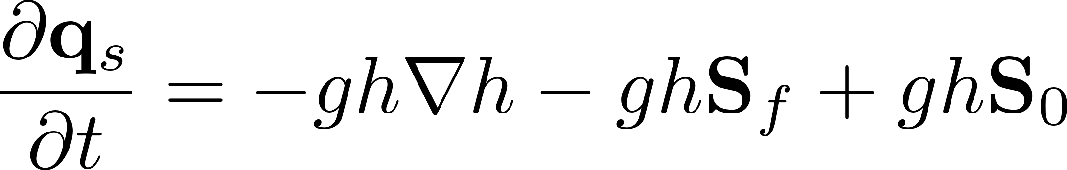
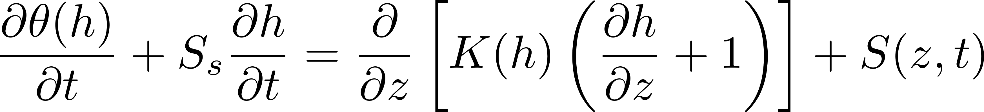
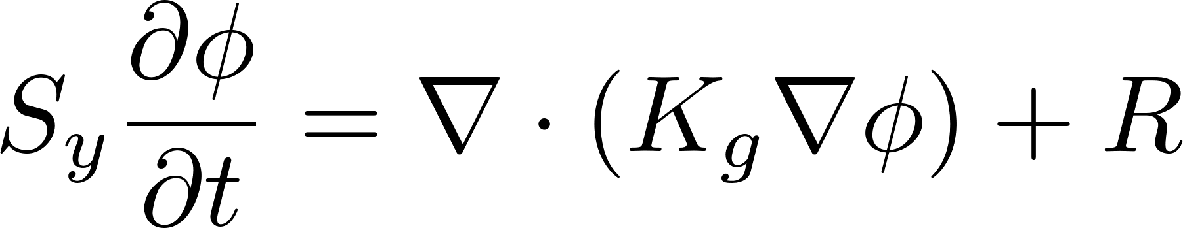
HydroPol2D Model
Cell-by-cell Mass Balance
Build-up and Washoff for Pollutant Transport and Fate
Local-Inertial Shallow-Water Model
1D Mixed-Form Richards Model for Vadose Zone
2D Boussinesq Model For Saturated Perched Aquifers

Slide 4
Case-Study
Permeable Pavements
Four different top engineered permeable surface
Media consisting of ASTM #8 (~ 0.2 m), ~ ASTM #2 (~0.1 m) and ~ 0.02 m permeable pavement surface
Previous modeling results indicate a proper approximation of the problem in 1D
Source: Brasil et al., (2025)

Slide 5
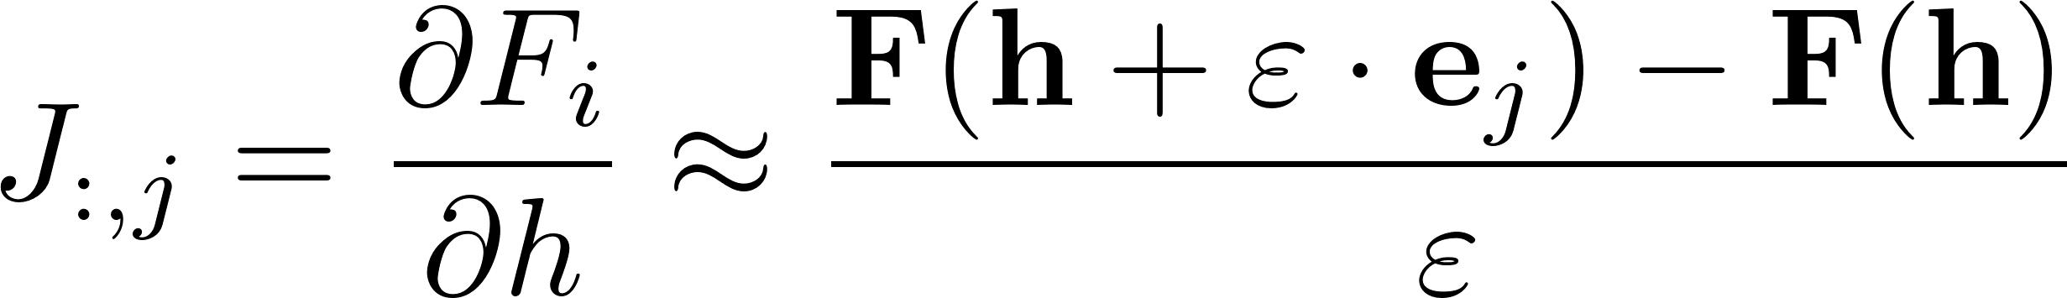
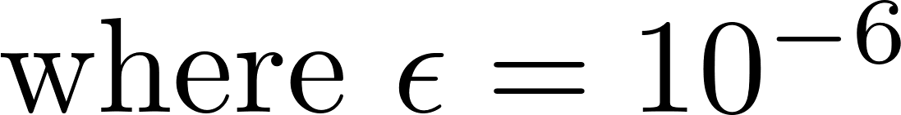
Mixed-Form Richards Equation Solver
Solution Procedure:
Compute Residual
Compute Residual Jacobian Matrix
Perform a full Newton-Rapshon Step
Perform line-search (if required)
Calculate adaptive time-stepping
Repeat until the end
Numerical Jacobian
A first attempt to derive an explicit solution Richards model was developed but resulted in an unfeasible model for real-world applications due to not irrelevant mass balance errors

Slide 6
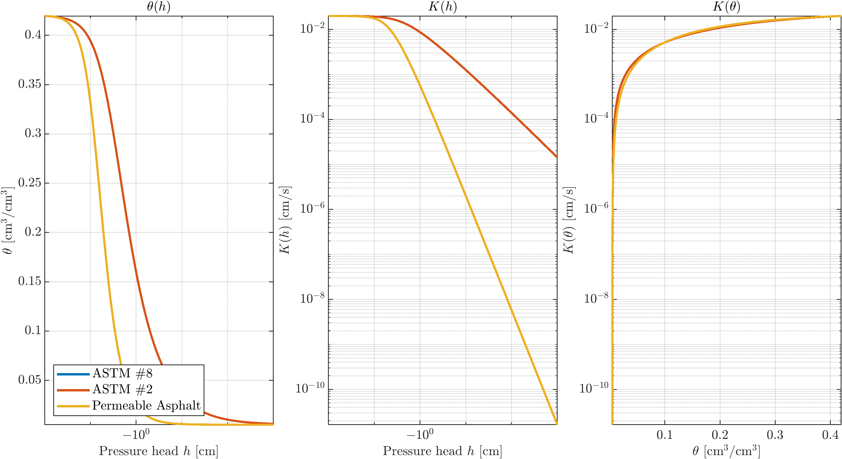
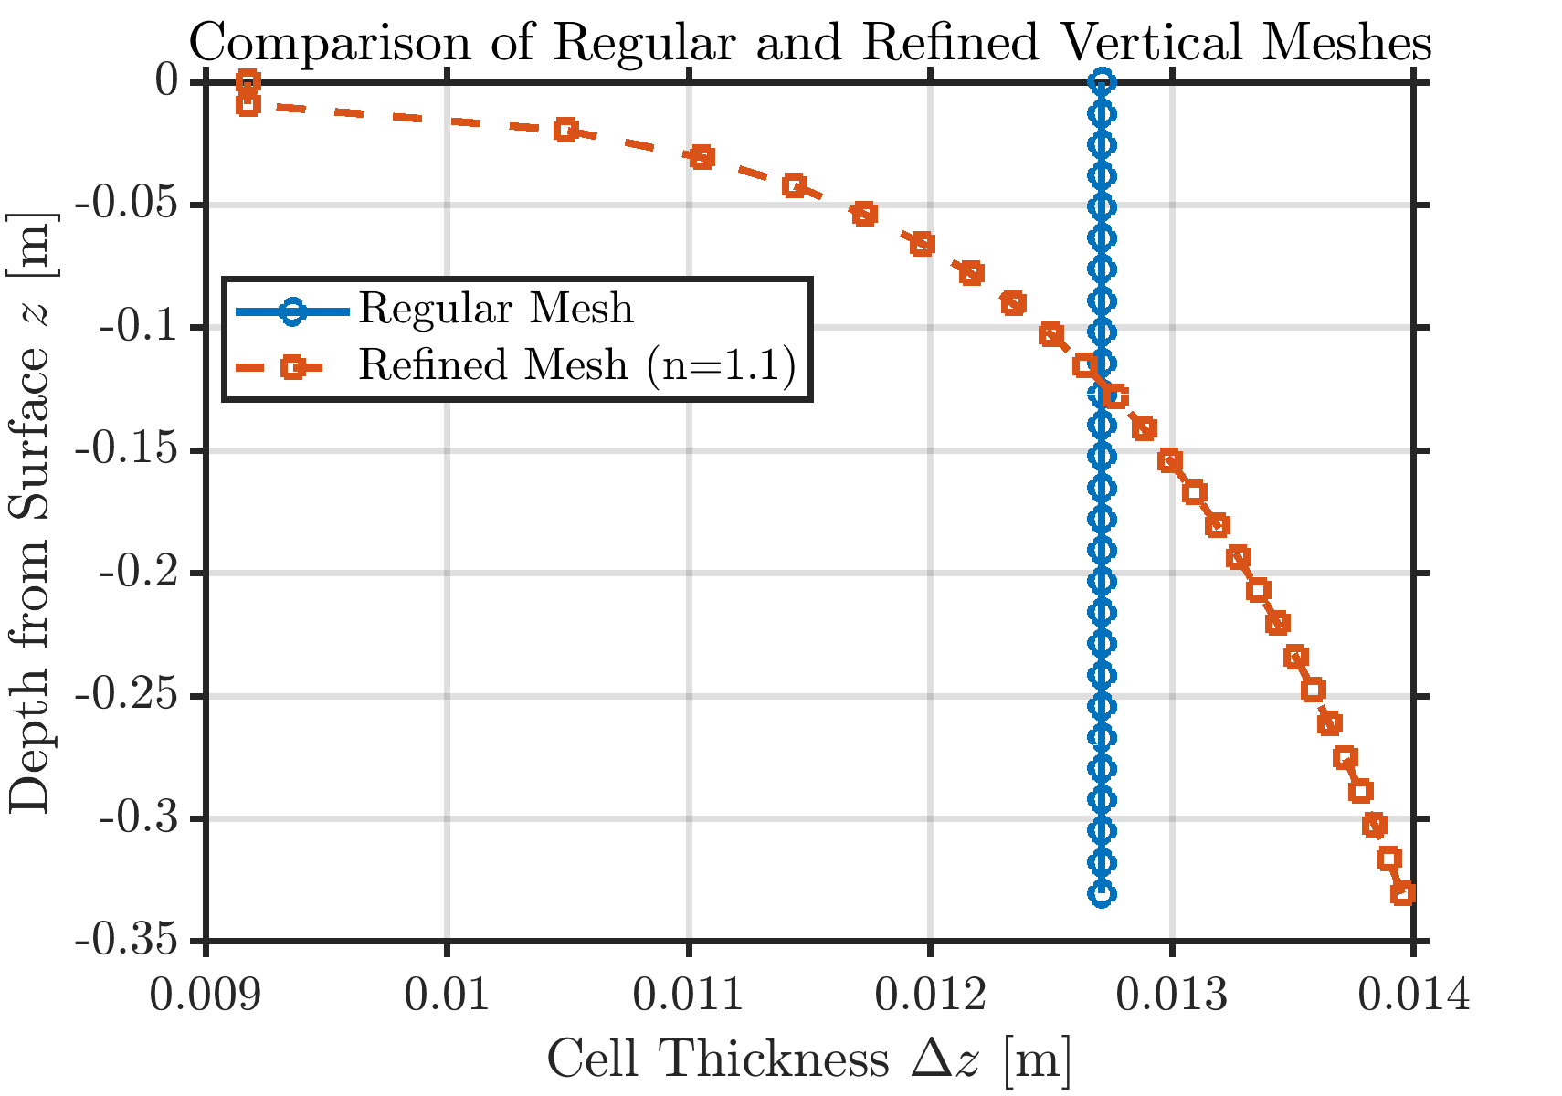
Media Constitutive Relationships and Vertical Mesh
Parameter | ASTM #8 | ASTM #2 | Permeable Asphalt
van Genuchten alpha (1/m) | 7.5 | 3.5 | 7.5
van Genuchten n (–) | 2.5 | 1.75 | 2.5
Residual water content θr (–) | 0.005 | 0.005 | 0.005
Saturated water content θs (–) | 0.42 | 0.42 | 0.42
Specific storage Ss (1/m) | 5×10⁻⁵ | 1×10⁻⁴ | 1×10⁻⁴
Sat. hydraulic conductivity Ks (m/s) | 2×10⁻² | 2×10⁻² | 2×10⁻²

Slide 7
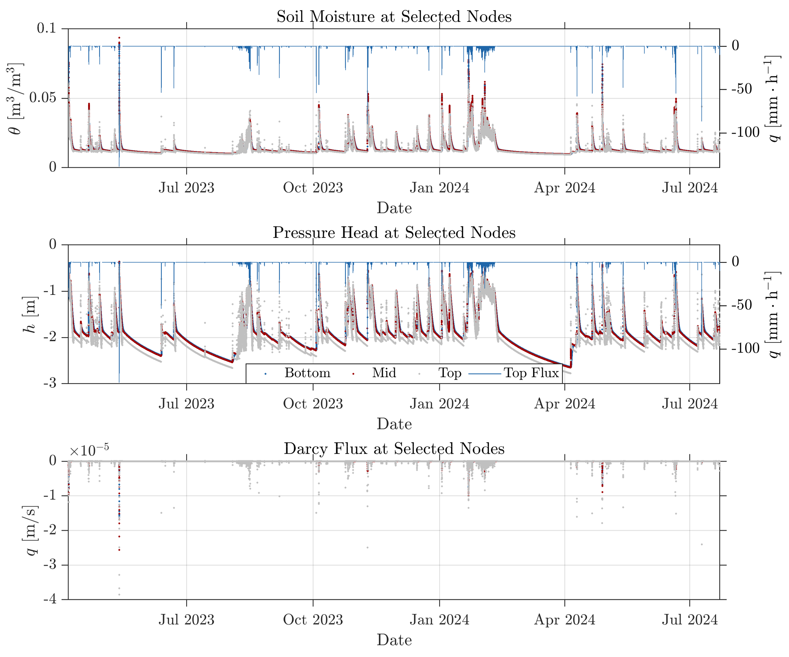
Case Study
Evolution of Water Content, pressure head, and darcy flux
Evaporation modeled with Hargreaves with daily climatologic inputs
Data at top, mid, and bottom nodes
Bottom boundary condition: Free-Flow
Top Boundary Condition: Neumann

Slide 8
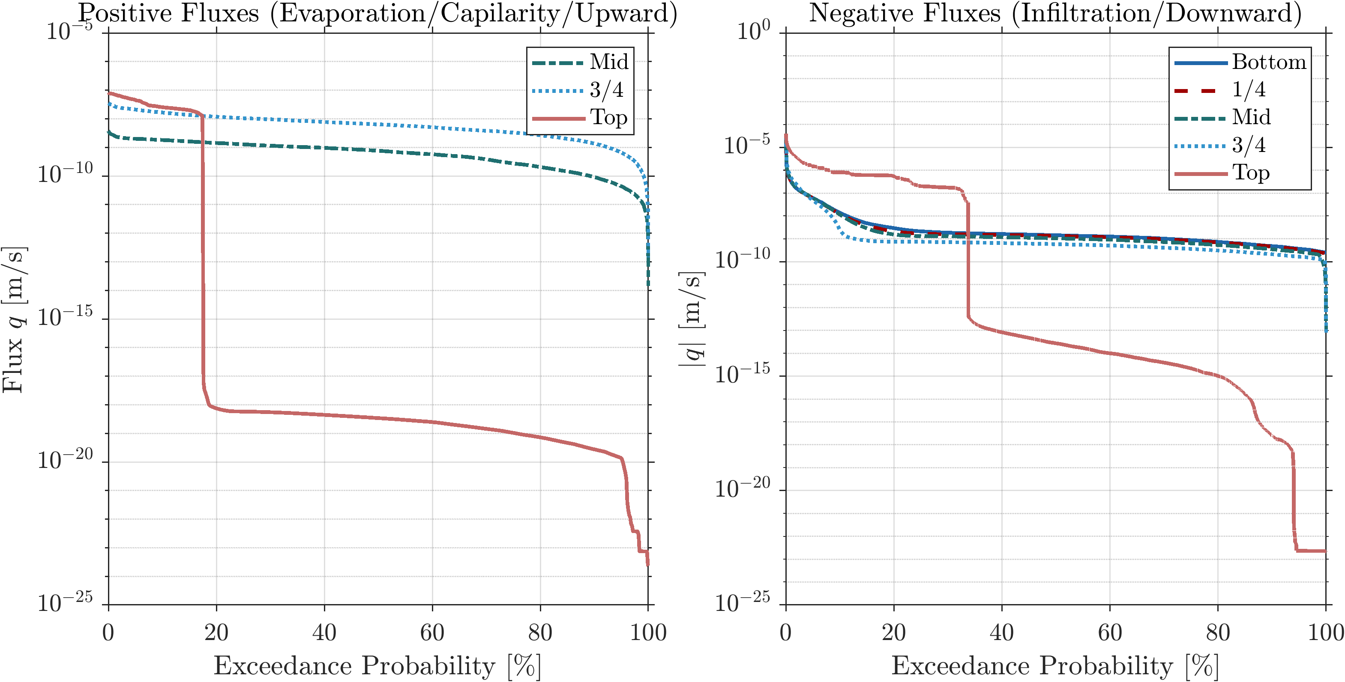
Case Study
Flow duration curves indicate that during upward fluxes, only 20% of the time meaningful evaporation fluxes are observed
Evaporative head gradient is not strong enough to uptake moisture from deeper nodes
Infiltration at the top drives moisture downwards in nearly 30% of the time
The main governing hydrological characteristic of the system is being “water-limited” rather than “energy-limited”

Slide 9
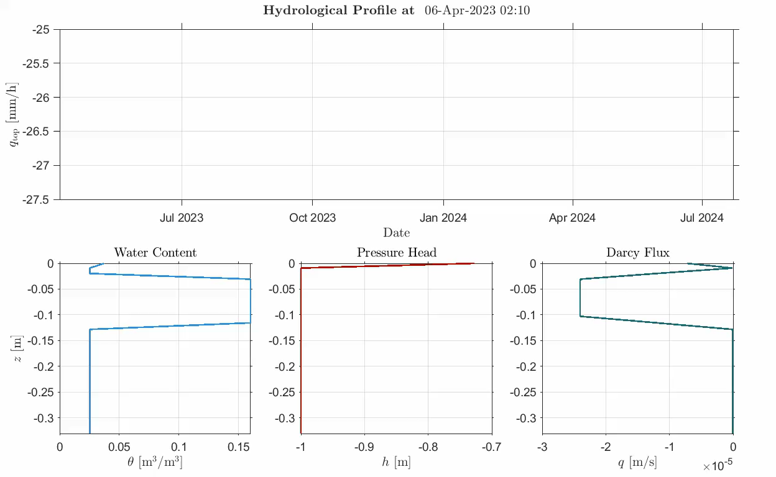
Temporal Evolution of Model States

Slide 10
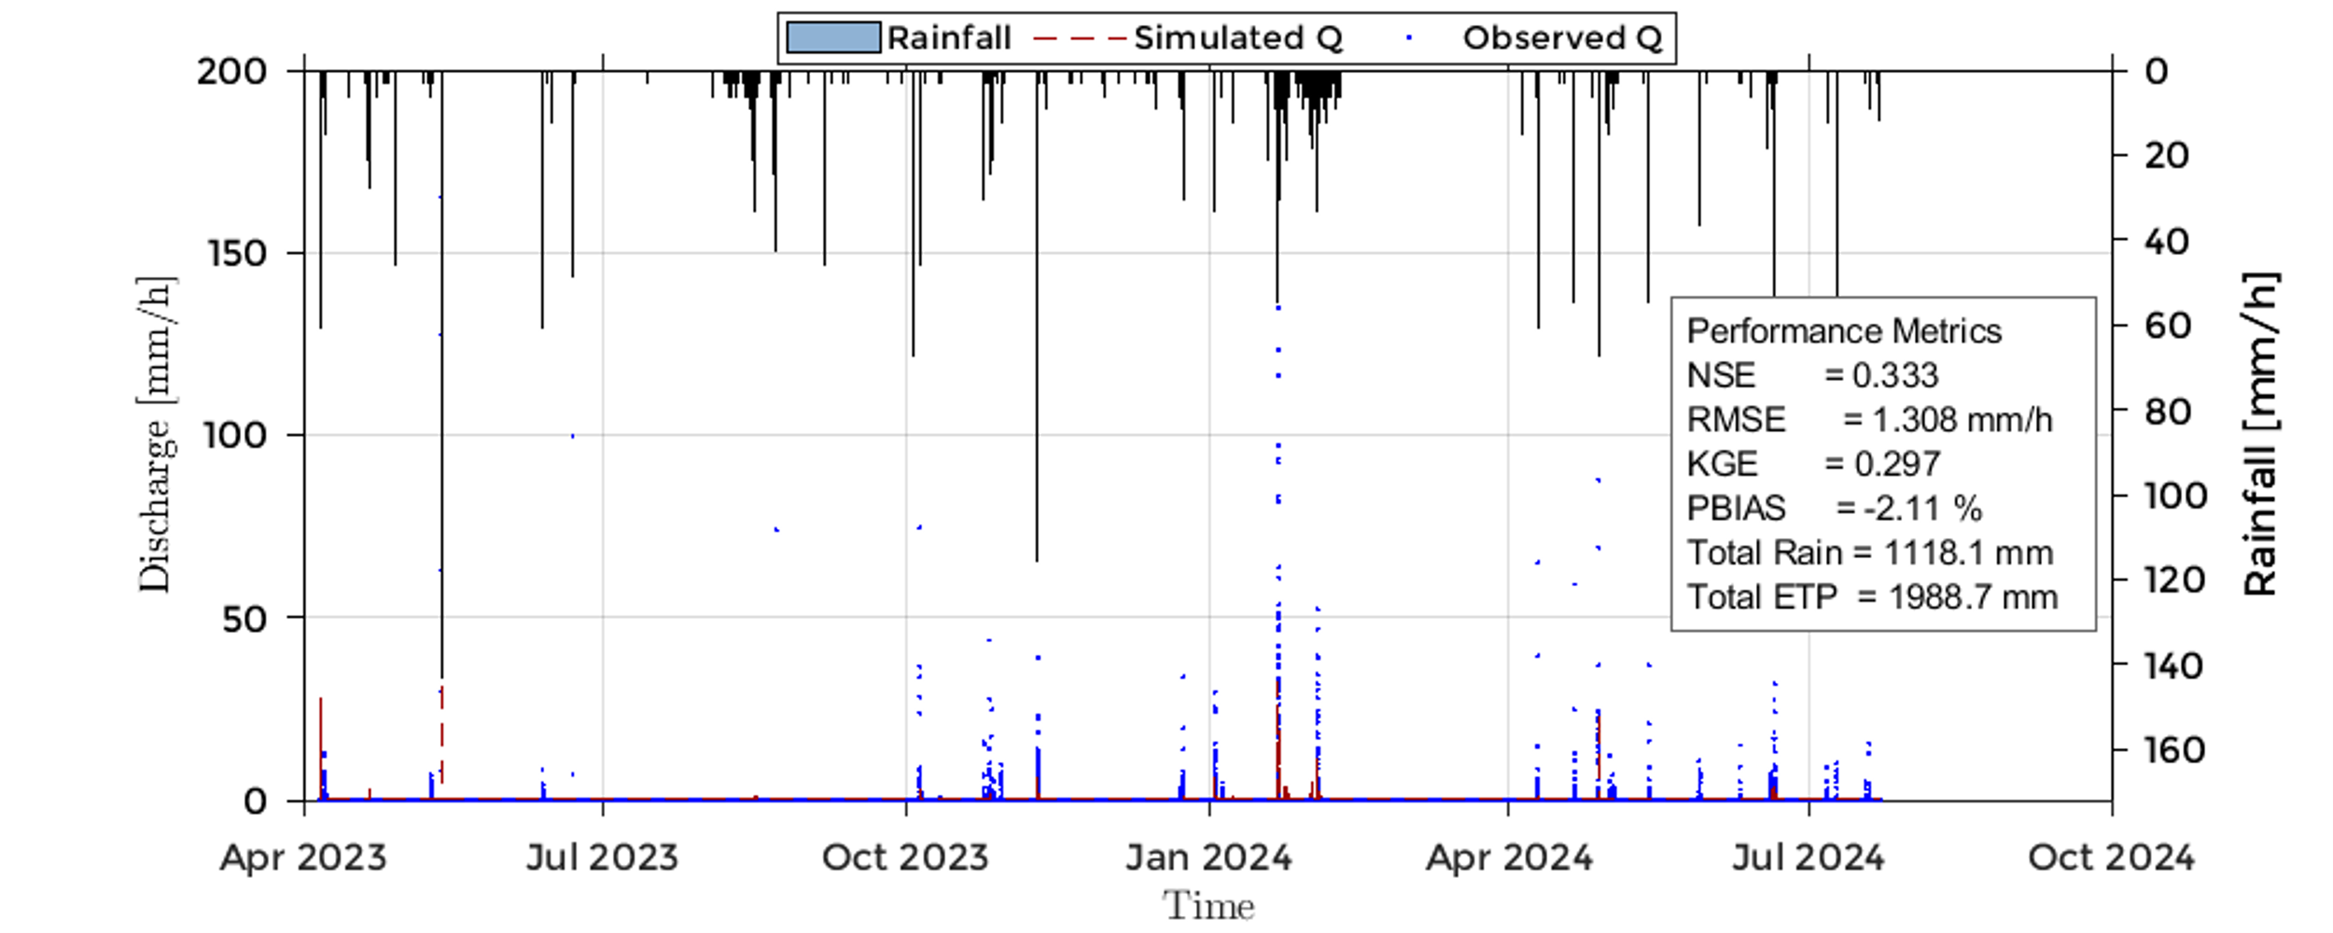
Bias Correction / Model Verification
Inter-event bias in datum level of flow meter hinders our capacity to accurately capture outflow dynamics and evaluate model application
Aiming to reduce bias in the flow meter level, an event-by-event level bias optimization was performed attempting to match 90% of the rainfall volume after a 6-hours period of the end of the rainfall.
Resulting level was later used in ‘calibrated flow meter rating curve to convert level in flow discharge

Slide 11
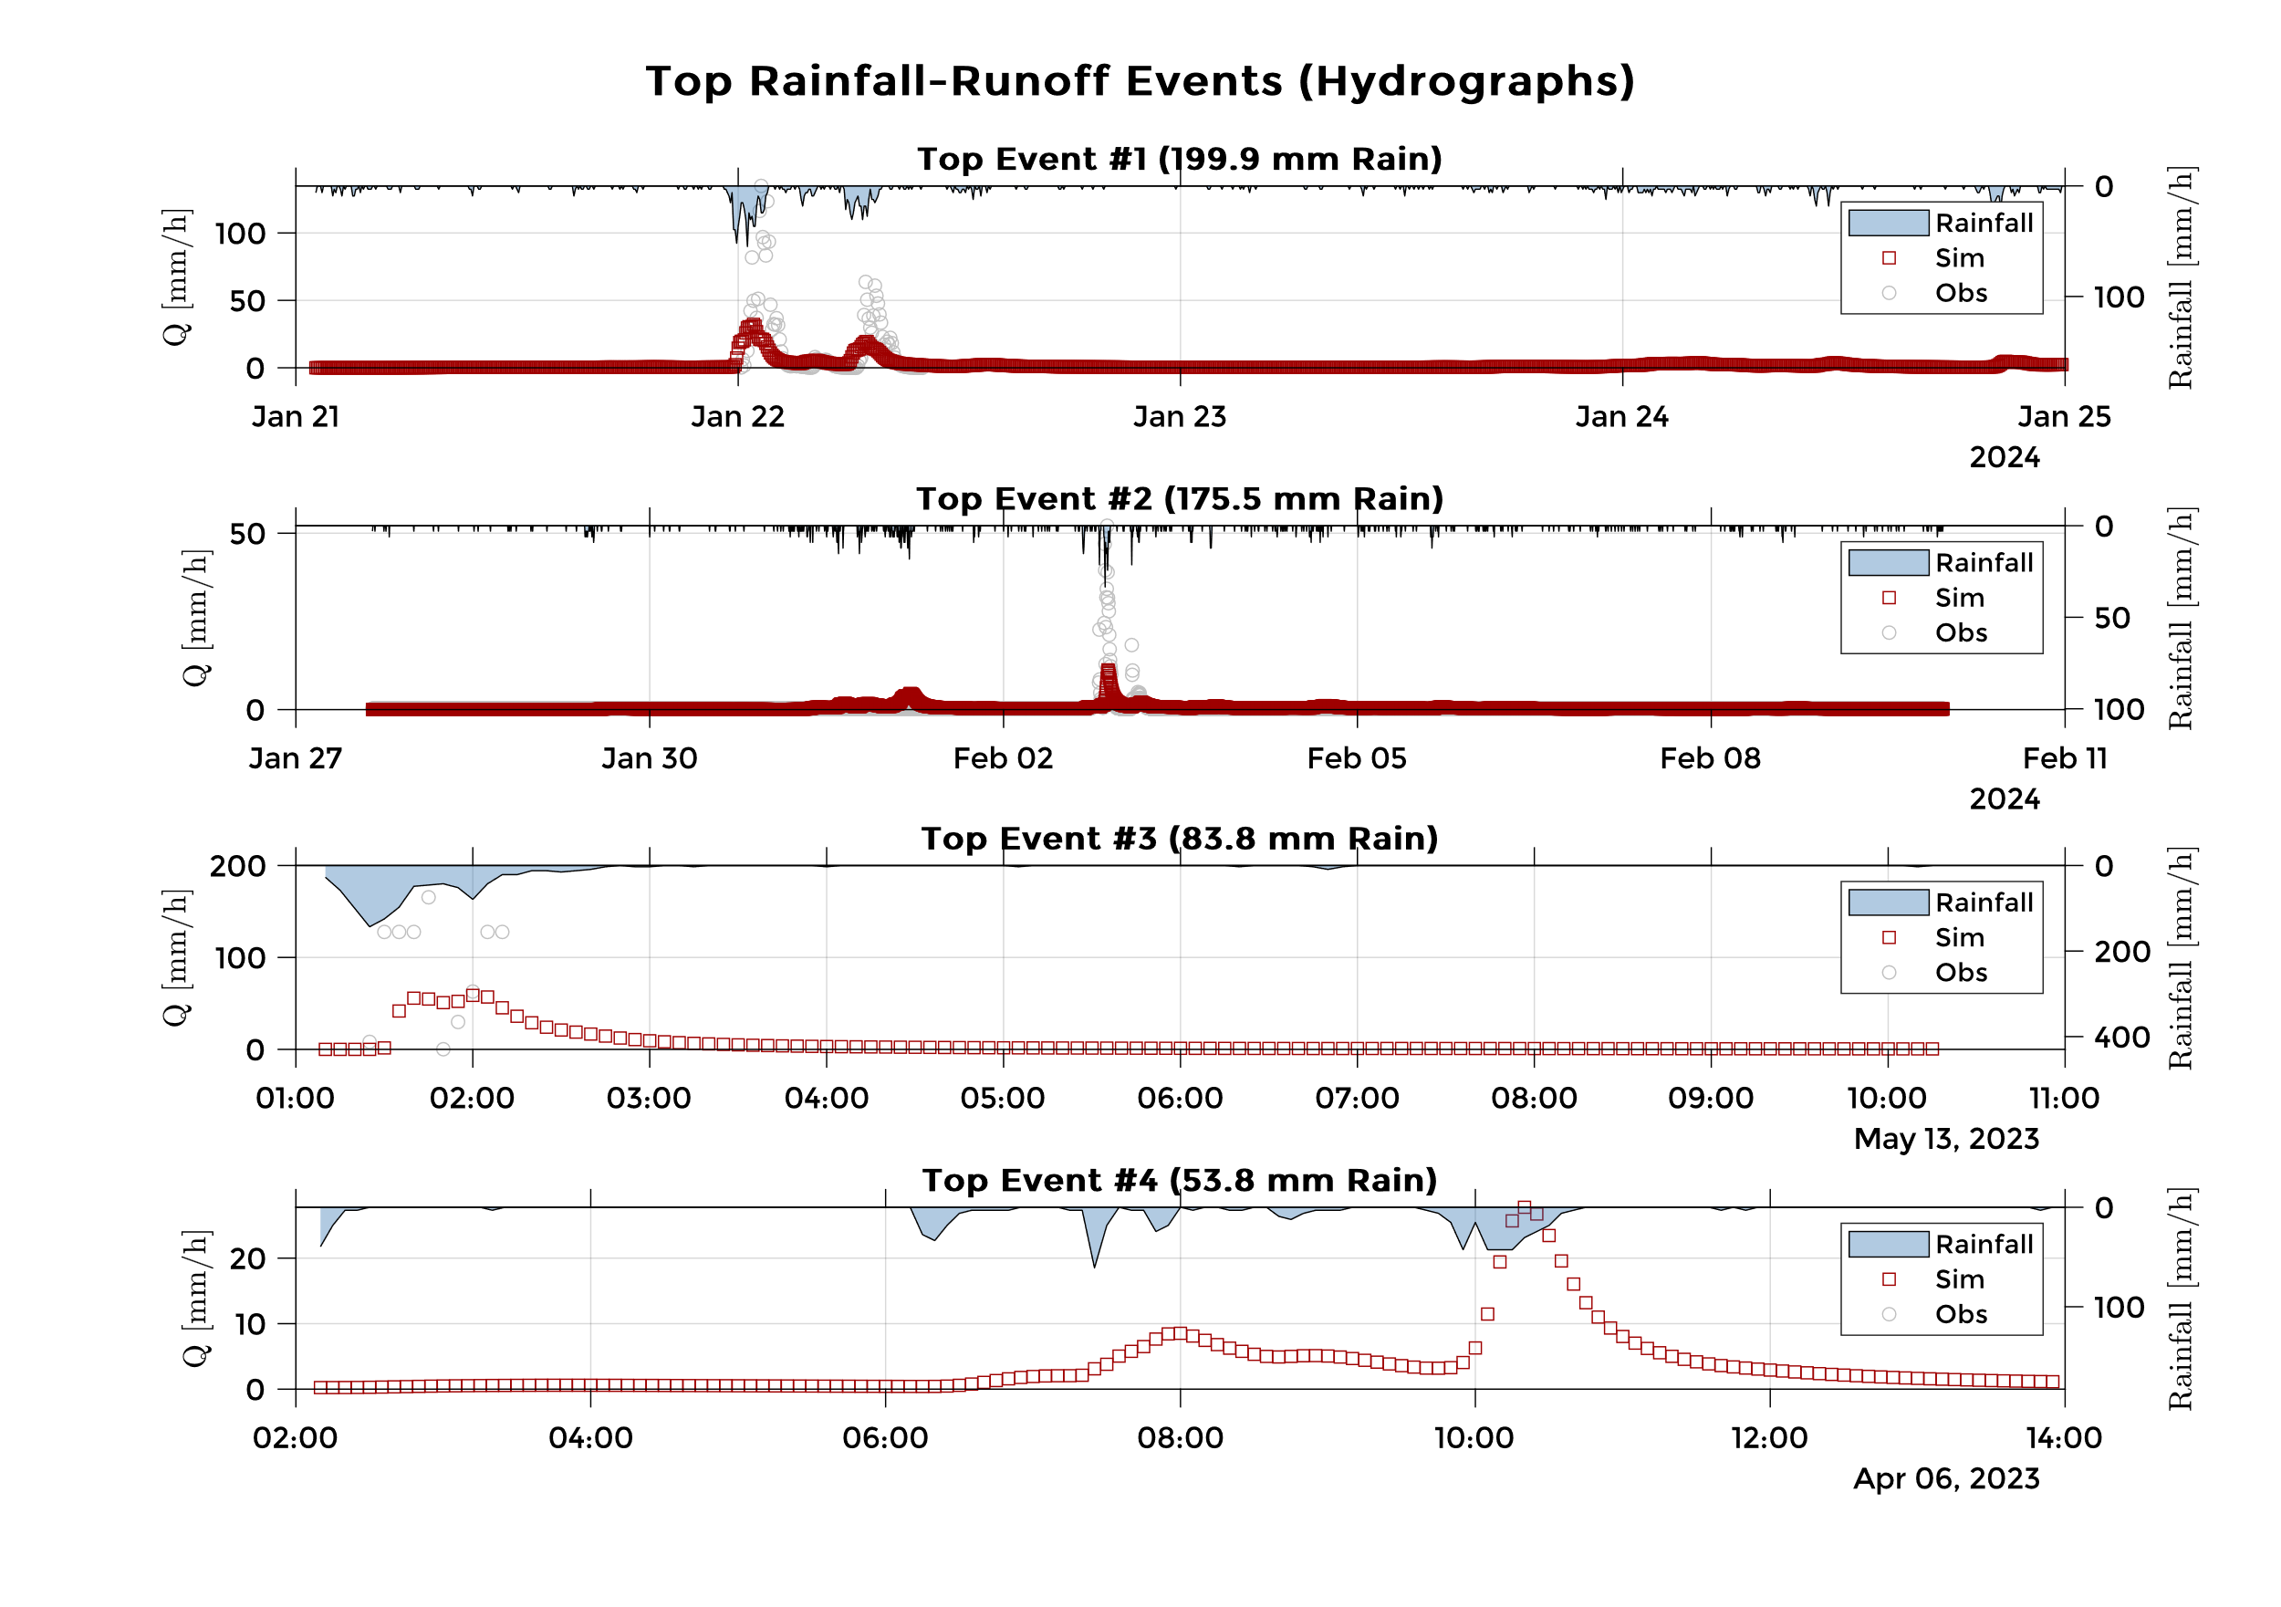
Bias Correction / Model Verification
Some observed events had observed seepage discharge larger than the rainfall rate, even after bias correction, which is unlikely
Uncertainties associated with flow measurement are focus of future studies
These results illustrate the model appropriate hydrological behavior under climate forcing. Simulate runoff was never greater than rainfall

Slide 12

Final Remarks
A coupled solver of 1D Mixed-Form Richardson-Richards Equation was developed
The solution is made through linearizing the system of equations through and solving it via a Newton-Raphson algorithm coupled with a line-search approach
Preliminary results of applying the model under nearly 450 days of continuous simulation indicates appropriate hydrological behavior
Previous results, not presented in this presentation, indicates good numerical accuracy against Hydrus 1D Model and Celia 1990 numerical examples
The model is under development and available at:
https://github.com/marcusnobrega-eng/LID_Tool
Thank you for your time
If you have any questions, please reach me at
marcusnobrega.engcivil@gmail.com
https://marcusnobrega-eng.github.io/profile/

